Slide 1

Calculating Churn Rate
Learn SQL from Scratch
By: Jason Matza

Slide 2
1. Get familiar with Codeflix
How many months has Codeflix been operating?
What segments of users exist?
2. What is the overall churn trend since inception?
Step-by-step breakdown to calculate churn
3. Compare the churn rates between user segments
Which segment of users should Codeflix focus on expanding?
TABLE OF CONTENTS
GET FAMILIAR WITH CODEFLIX
OVERALL CHURN TREND
CHURN RATES BETWEEN SEGMENTS

Slide 3
1. Getting Familiar With Codeflix

Slide 4
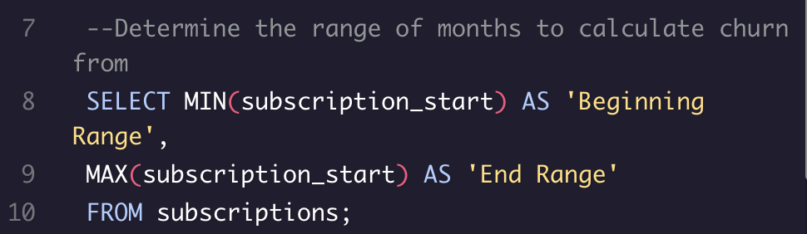
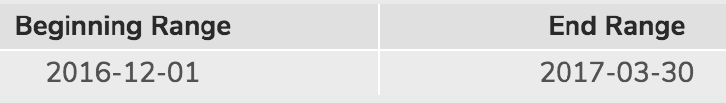
1. Get Familiar with the Company
How many months has Codeflix been operating?
By using MIN/MAX values based on the subscription start field, we can determine the number of months the company has been operating
MIN(column_name) shows the minimum value in the column. In this case, the minimum value of subscription_start is 2016-12-01
MAX(column_name) shows the maximum value in the column. In this case, the maximum value is 2017-03-30

Slide 5
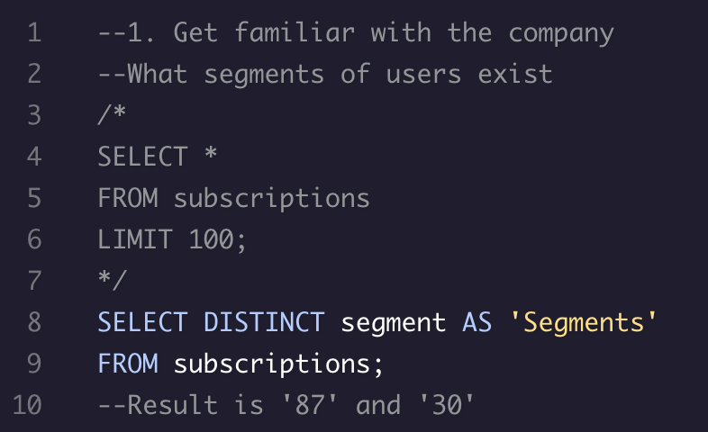
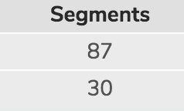
1. Get Familiar with the Company - Continued
What segment of users exist?
Code lines 4-6 shows one way to view the different segments but it is possible that not all the segments appear in the first 100 rows.
Finding the DISTINCT values of the segments is the quickest way to find the segment names.
DISTINCT only shows the unique row values
LIMIT is used to specify the maximum number of rows returned.
Makes queries run faster
Always goes at the end of the query

Slide 6
2. What is the Overall Churn Rate
By Month

Slide 7
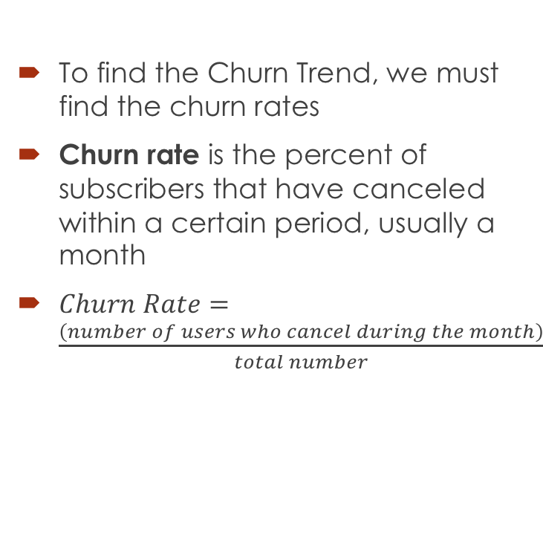
2. Overall Churn Trend
To find the Churn Trend, we must find the churn rates
Churn rate is the percent of subscribers that have canceled within a certain period, usually a month
$Churn Rate=\frac{\left(number of users who cancel during the month\right)}{total number}$

Slide 8
Step-by-step breakdown to calculate Churn
What do we currently have?
Segments: 87, 30
Range: 12/01/2016 to 3/30/2017
What we still need to calculate churn:
Months (subscriptions table missing months reference)
JOIN table (join months with subscriptions)
Status classification table
Status aggregate
Calculate churn rate

Slide 9
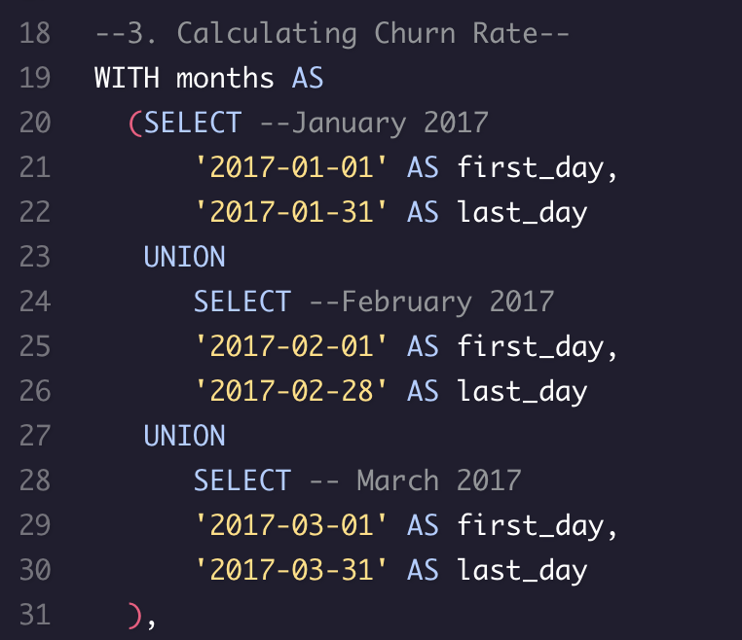
2a. Creating a temporary Months table
WITH clause is used as a more organized way to organize your data than subqueries
WITH {table_name} AS ({subquery_body}),
Codeflix requires a minimum subscription of 31 days
There is no churn in the first month so we don’t add it to the months table
We use UNION to stack the data on top of each other to form a complete months table

Slide 10
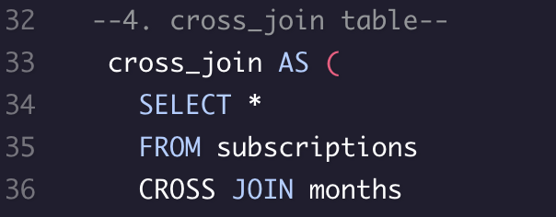
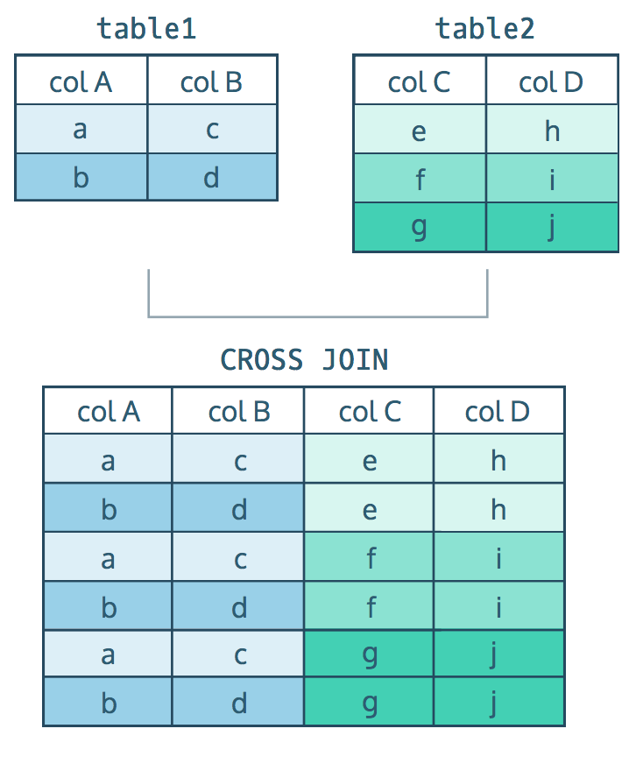
2b. Join Table
There are different ways to join a table:
Query starts with:- SELECT * FROM table1…{JOIN}
Inner JOIN – matches each row on a table with rows of a second table based on common column. Results will only show rows where there is a match.
LEFT JOIN – matches each row by common column. Will display all the data from the first table and additional data from the second table where there is no match.
CROSS JOIN – combines all rows from one table with all the rows from another (see example)
UNION – stacks one dataset on top of another
CROSS JOIN was used to add the month columns to the subscriptions table

Slide 11
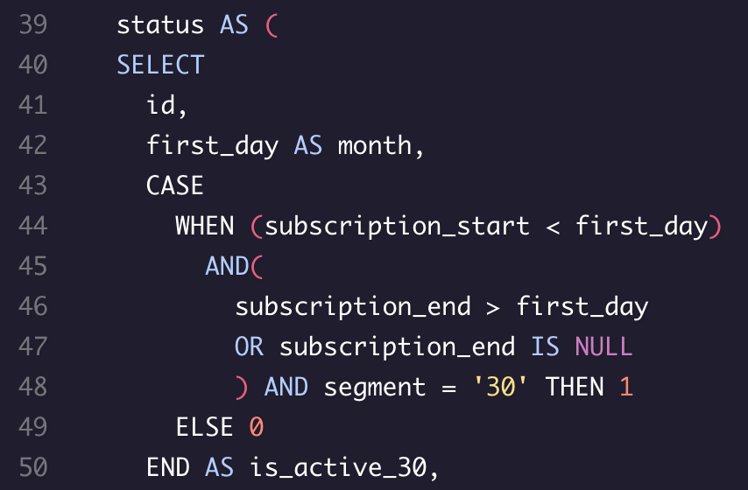
2c. Status table
CASE WHEN statements are used the same way as an IF statement is in Excel. Evaluates conditions in sequence & stops once condition is satisfied.
AND signifies that both conditions must be true in order for the statement to be true
{a-True} AND {b-False} = False
OR signifies that at least one condition must be met for the statement to be true
True OR False = True
ELSE – output when none of the WHEN statements are TRUE.
END is required & always comes at the end of a CASE WHEN statement

Slide 12
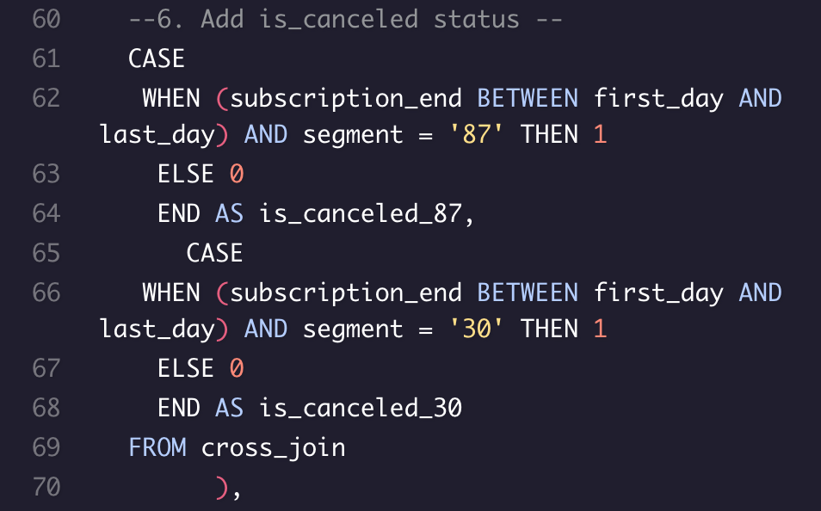
2c. Status table – Cont.
WHEN a subscription ends BETWEEN the first AND last day, this means the subscription was canceled
BETWEEN is used in conjunction with AND to select values within a given range (numbers, text, or date). Note: text is not inclusive
BETWEEN {start_date} AND {end_date}

Slide 13
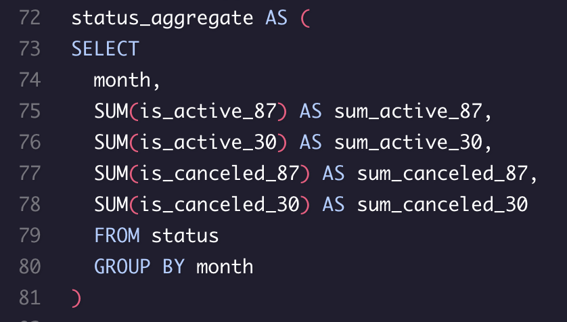
2d. Status Aggregate table
We need to aggregate our now categorized subscriptions
Aggregate functions are calculations that are performed on multiple rows (COUNT, MAX, MIN, SUM, AVG)
GROUP BY is used to with aggregate functions to group the results
Now we are ready to calculate our churn rate

Slide 14
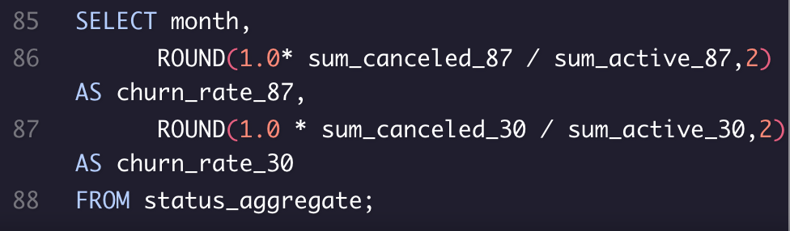
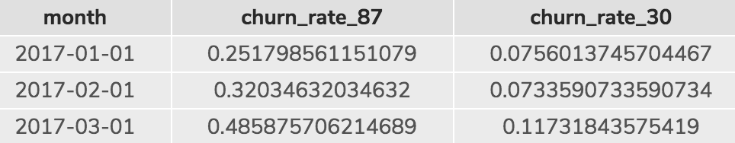
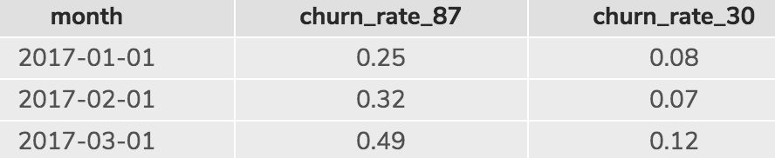
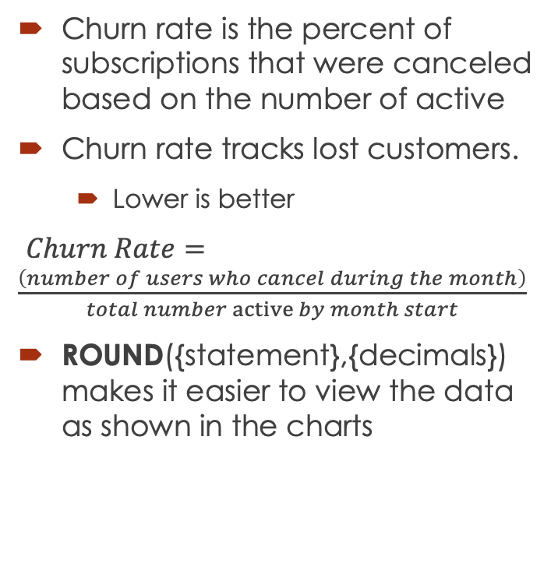
Calculating Churn Rate
Churn rate is the percent of subscriptions that were canceled based on the number of active
Churn rate tracks lost customers.
Lower is better
$Churn Rate=\frac{\left(number of users who cancel during the month\right)}{total number active by month start}$
ROUND({statement},{decimals}) makes it easier to view the data as shown in the charts

Slide 15
3. Compare Churn Rates between
Segments

Slide 16
What segment should Codeflix focus on expanding?
Answer: Segment 30
Segment 30 churn rate is much lower than Segment 87
The lower the churn rate, the longer the product is expected to survive
A high churn rate indicates a lower survival rate.
The higher the churn, the greater the subscription amount needed

Slide 17
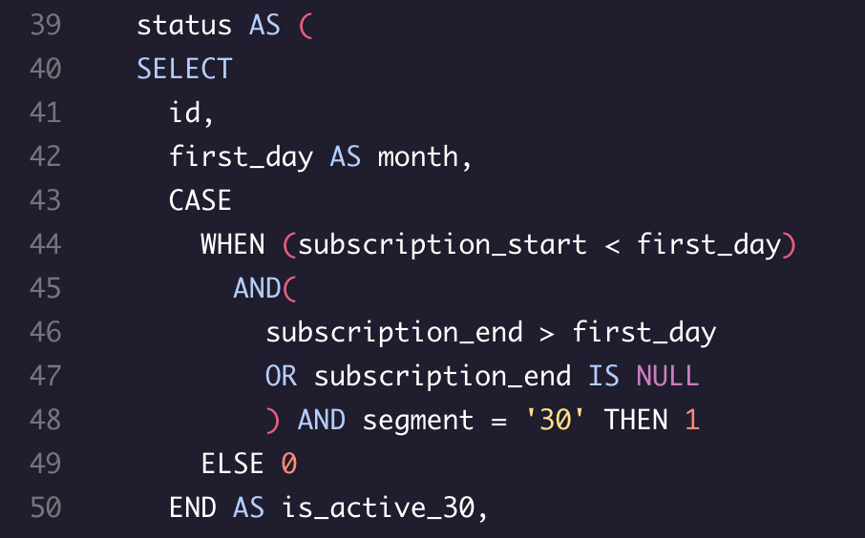
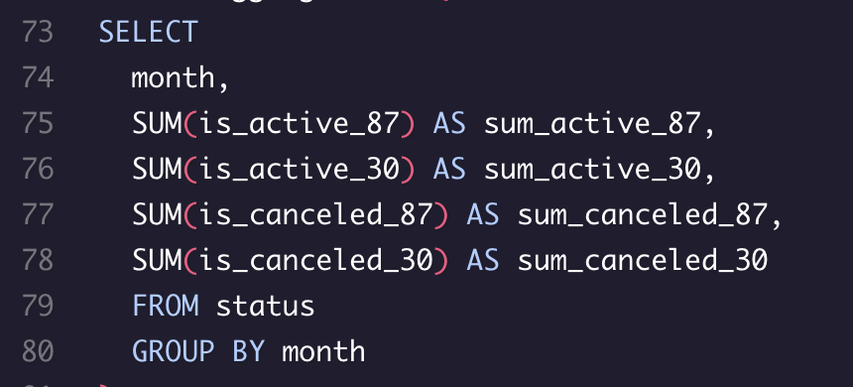
Bonus – How would you modify the code to support a large number of segments?
Remove the ‘segment’ reference from the WHEN statements
Add segment to the SELECT section before CASE (line 42)
Change is_active_30 to is_active and do the same for is_canceled (line 50)
Status table should now show the status as ‘is_active’ and ‘is_canceled’
In the status_aggregate table (73-80) add ‘segment’ into GROUP BY after month
Remove all the hardcoded parts of the code

